Slide 1
Tom Dixon is a graduate of the University of Florida with a Bachelor’s degree in Building Construction and a Master's Degree in Real Estate. He has held the designation MAI as a Member of the Appraisal Institute and was a State of Florida Certified General Appraiser.
He is the 2004 Chairman of the Miami Realtors with now over 40,000 members. He is the 2006 President of the Industrial Commercial Association of South Florida “CIASF”. For the past 26 years he has prepared and presented the “South Florida Industrial Market Report”, and for the first “Official Office Market Report” for the Commercial Industrial Association of South Florida.
His brokerage assignments include the sale of vacant commercial/industrial land, retail/office buildings and industrial/warehouse buildings. He has developed office buildings, warehouses and condominiums.
For the past 35 years he has been successfully providing tax assessment appeal services for both residential and commercial properties in South Florida. Currently with his son Andrew he continues to provide real estate tax assessment appeal and brokerage services with their company Dixon Commercial Real Estate, Inc.

Slide 2
Fundamentals of Commercial Real Estate Brokerage
Presented by:
Thomas J. Dixon
Dixon Commercial Real Estate, Inc.
For the
Miami Association of Realtors

Slide 3
LEVELS OF BROKERAGE
Referrals
Occasional transactions
Complete involvement

Slide 4
LEVELS OF BROKERAGE
Land Acquisition
Development
Leasing
Notes:
Types of Brokerage

Slide 5
BROKERAGE SERVICES
Financing
Property Management
Consulting
Selling

Slide 6
FACTORS FOR SUCCESS
Know The Product
Know The Client
Know The Market

Slide 7
KNOW THE PRODUCT
Land
Apartments
Industrial/Warehouse
Notes:
This is a list of property types description in other slides

Slide 8
KNOW THE PRODUCT
Office
Retail
Hospitality
Specialty

Slide 9
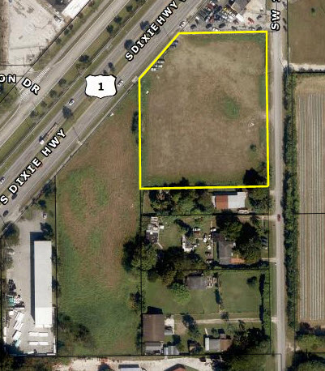
LAND INVESTMENTS
Notes:
Characteristics of Land

Slide 10
LAND INVESTMENTS
Long-term investment
Change in zoning
Change in use
Notes:
Characteristics of Land

Slide 11
LAND INVESTMENTS
Lack of liquidity
Low management requirements
Safety of ownership
No income tax benefits

Slide 12
MULTI-FAMILY
Stable income
Good financing and liquidity
Income tax benefits
Management intensive
Notes:
Characteristics of Apartments

Slide 13
MULTI-FAMILY
Duplex/Fourplex
Owner/user
Four to 60 Units
Individual or small partnerships
Notes:
Characteristics of Apartments

Slide 14
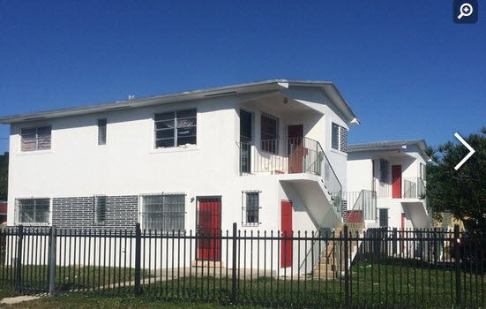
MULTI-FAMILY
Notes:
Characteristics Apartment

Slide 15
MULTI-FAMILY
More than 60 Units
Institutional investors or syndication with multiple owners

Slide 16
WAREHOUSE/INDUSTRIAL
Stable income
Lower management effort
Good financing and liquidity
Income tax benefits
Income from business occupants
Stable market
Notes:
Characteristics of Warehouses

Slide 17
WAREHOUSE/INDUSTRIAL
Distribution
Simple design, very large
Large dock height loading areas

Slide 18
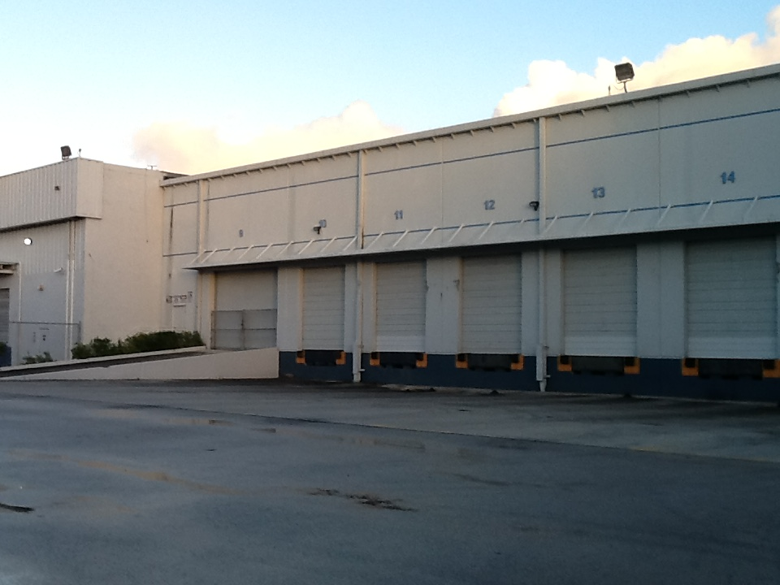
WAREHOUSE/INDUSTRIAL

Slide 19
WAREHOUSE/INDUSTRIAL
Local User
More permanent tenants
5 to 25% office
Street and dock height loading areas

Slide 20
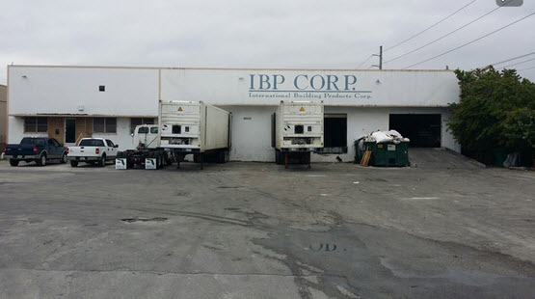
WAREHOUSE/INDUSTRIAL

Slide 21
WAREHOUSE/INDUSTRIAL
Office/Service
Park setting
Highest rents
Large AC areas

Slide 22
WAREHOUSE/INDUSTRIAL
Research and Development
Hybrid office and manufacturing
Special tenant requirements
Near labor bases

Slide 23
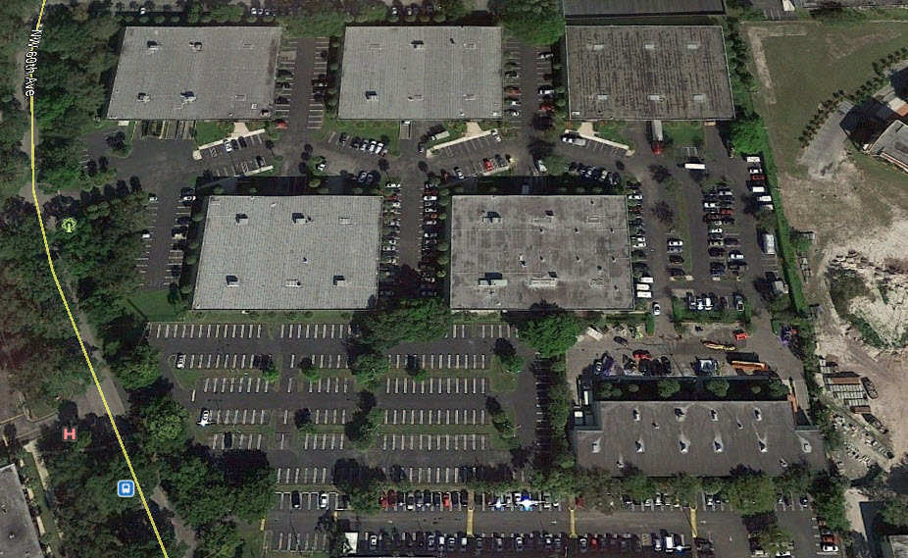
WAREHOUSE/INDUSTRIAL

Slide 24
OFFICE
Stable income from business tenants
Low management
Good financing and liquidity
Continued capital investments
Income tax benefits
Notes:
Characteristics of Offices

Slide 25
OFFICE
High-rise
Multiple stories (over 4)
Steel / concrete construction

Slide 26
OFFICE
Mid-rise
Below four stories
Suburban areas

Slide 27
OFFICE
Garden/Low-rise
1 to 2 stories
Simple design

Slide 28
OFFICE
Class A
Modern design
Under 10 years age
High-quality construction

Slide 29
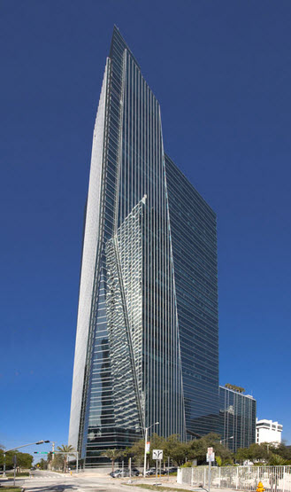
OFFICE

Slide 30
OFFICE
Class B or Class C
Older than 10 years
Functional problems
Older systems

Slide 31
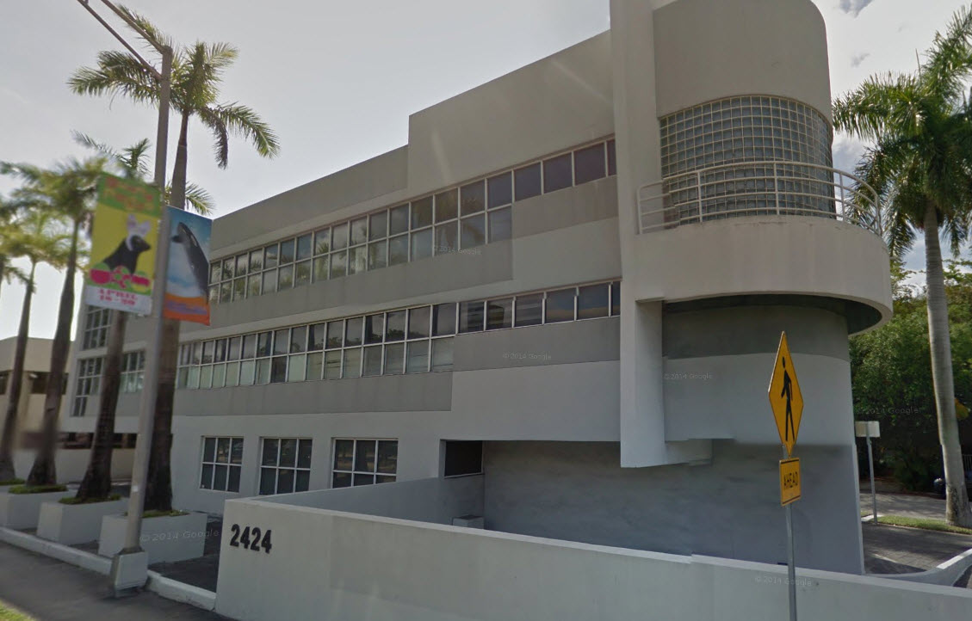
OFFICE

Slide 32
RETAIL
Stable income
Low management
Good financing and liquidity
Income from business tenants
Limited supply of properties for sale

Slide 33
RETAIL
Super Regional
Three or more major department stores
Over 1,000,000 SF
Notes:
Sawgrass Mills

Slide 34
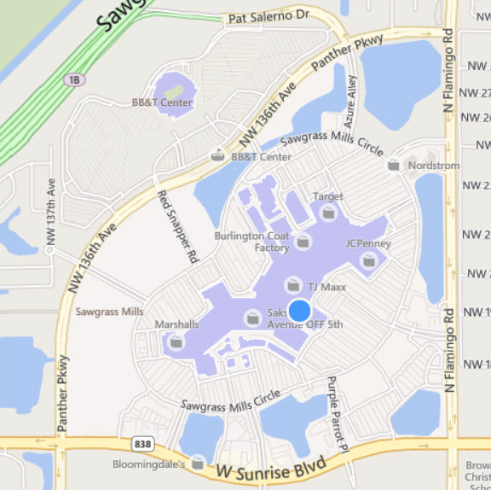
RETAIL – SUPER REGIONAL
Notes:
Sawgrass Mills

Slide 35
RETAIL
Regional
One to two department stores, variety and service
300,000 to 1,000,000 SF
Notes:
Dadeland, International Mall

Slide 36
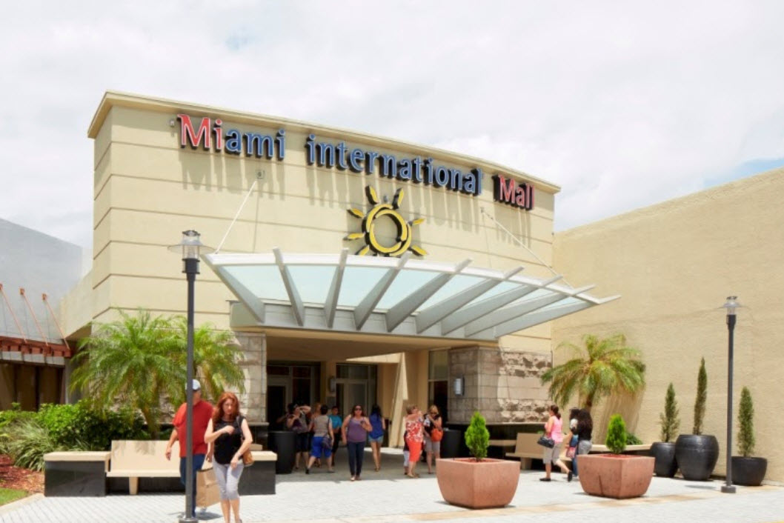
RETAIL - REGIONAL
Notes:
Dadeland, International Mall

Slide 37
RETAIL
Community
Supermarket or department store, variety store or discount store
100,000 to 300,000 SF
Notes:
Ikea

Slide 38
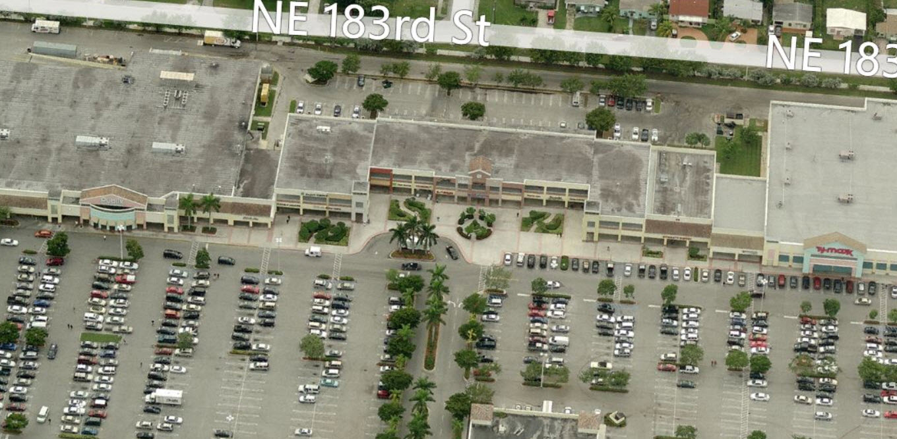
RETAIL - COMMUNITY
Notes:
Ikea

Slide 39
RETAIL
Neighborhood
Supermarket or drugstore
30,000 to 100,000 SF
Notes:
Winn-Dixie, Publix

Slide 40
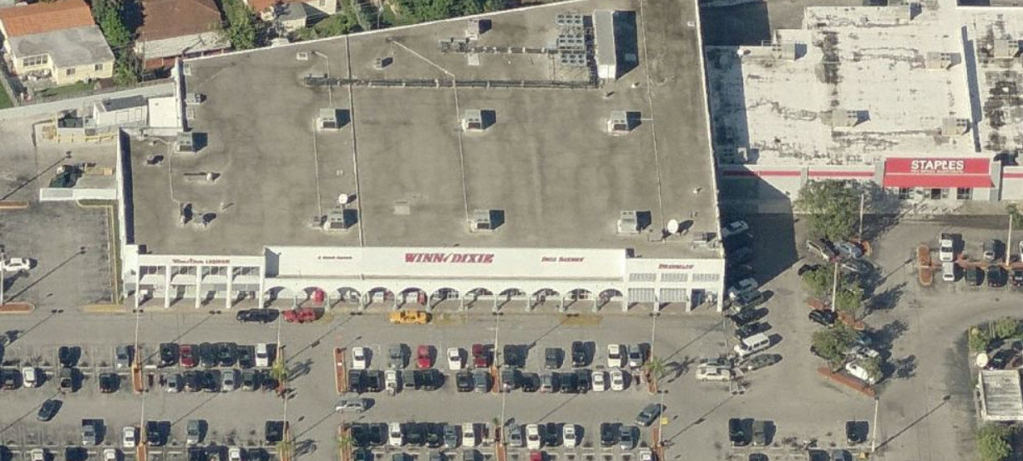
RETAIL
Notes:
Winn-Dixie, Publix

Slide 41
RETAIL
Strip Center
Linear with anchor tenant at each end 10,000 to 20,000 SF

Slide 42
RETAIL
Specialty or Theme Center
No anchor
Based on a type of business
Local impact
Notes:
Dave and Busters, Outdoor World

Slide 43
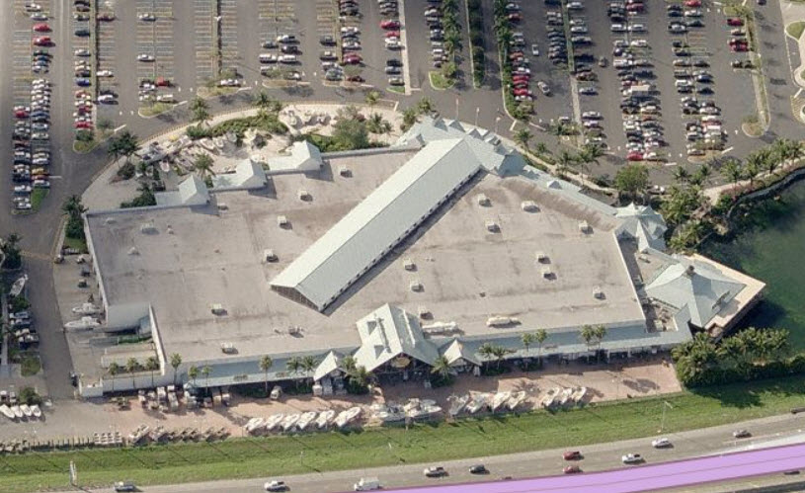
SPECIALTY
Notes:
Dave and Busters, Outdoor World

Slide 44
HOSPITALITY
Combination of real estate and business
Management intensive
Variable income
Limited financing and liquidity
Complex properties
Notes:
Hotels, Restaurants

Slide 45
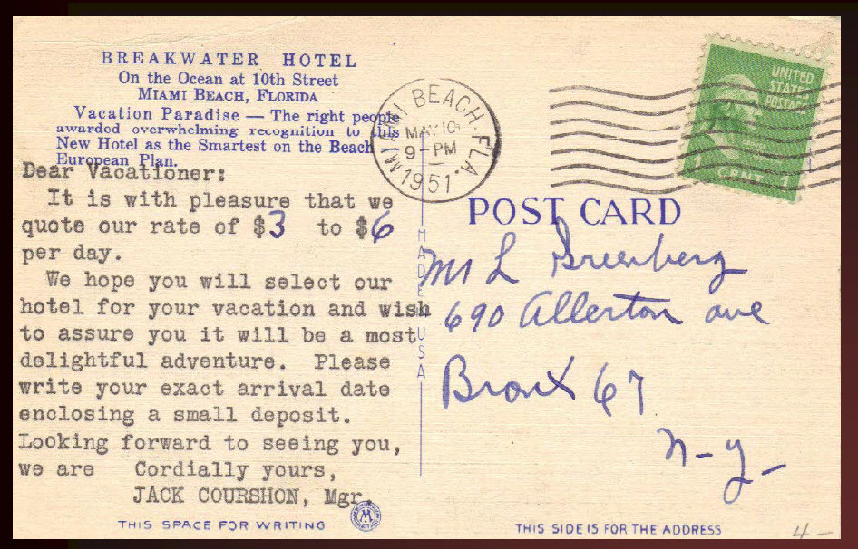
HOSPITALITY
Notes:
Hotels, Restaurants

Slide 46
OTHER PROPERTY TYPES
Adult Congregate Living Facilities (ACLF)
Nursing Homes
Amusement/Entertainment Facilities
Notes:
Movie theater

Slide 47
OTHER PROPERTY TYPES
Mobile Home Parks
Land Leases
Mixture of investment factors
Religious

Slide 48
DEFINITIONS - RENT
Contract Rent – Rent actually paid
Market Rent - Current rent in the market
Base Rent - (retail) before overage
Overage - Payment above base rent
Ground lease rent - Land only

Slide 49
DEFINITIONS - EXPENSES
Utilities
Waste Removal
Real Estate Taxes
Insurance
Common Area Maintenance (CAM)
Reserves for Replacements

Slide 50
DEFINITIONS - EXPENSES
Repairs
Maintenance
Security
Management Fees
Parking

Slide 51
DEFINITIONS - FINANCIAL
Liquidity - Quickly convert to cash
Leverage - Borrowed funds
Taxation - Income taxes

Slide 52
DEFINITIONS - FINANCIAL
Yield - Investment Performance
Cash Flow - Income after debt

Slide 53
DEFINITIONS - RISK
Risk - possibility of loss
Purchasing Power - Inflation
Financial Risk - Leverage
Business Risk - Demand for product
Market Risk - Overall decline

Slide 54
DEFINITIONS - LEASES
Gross Lease - Landlord pays all expenses
Net Lease - Landlord pays some expenses
Percentage Lease - Tenant pays percentage of gross sales
Ground Lease - Lease on land only
Sublease - Tenant subleases all/part of space

Slide 55
DEFINITIONS - LEASES
Assignment - Tenant transfers all interest to another party
Turnkey Lease - Landlord prepares property for tenant
Sale/Leaseback - Property is sold and leased back to tenant

Slide 56
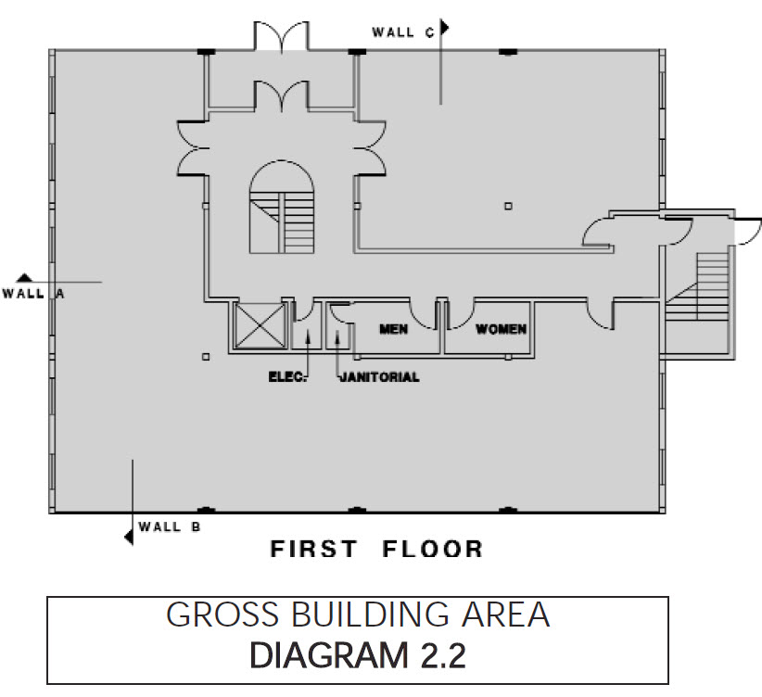
SPACE MEASUREMENTS
Gross Building Area (GBA)

Slide 57
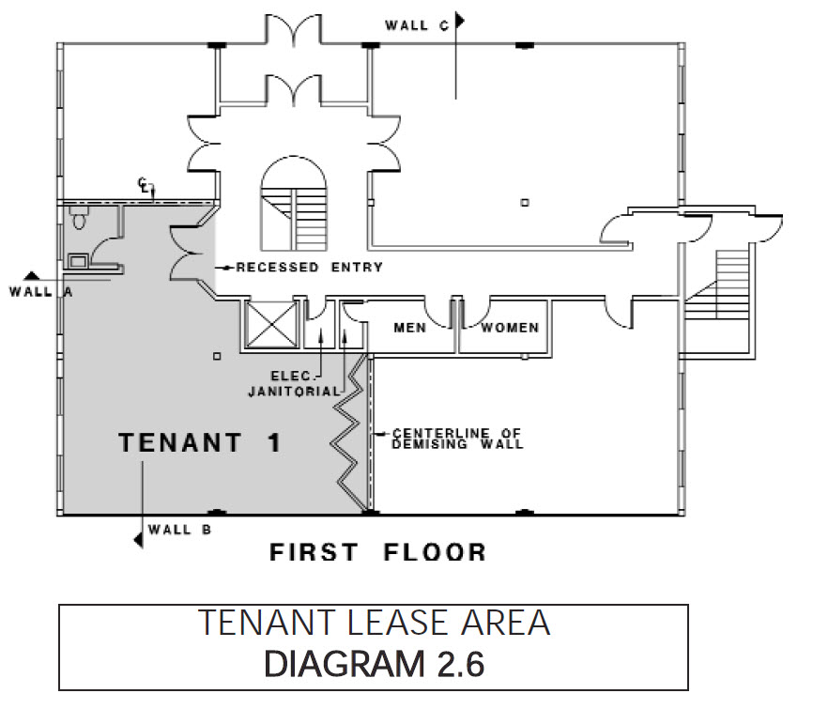
SPACE MEASUREMENTS
Net Rentable Area (NRA)

Slide 58
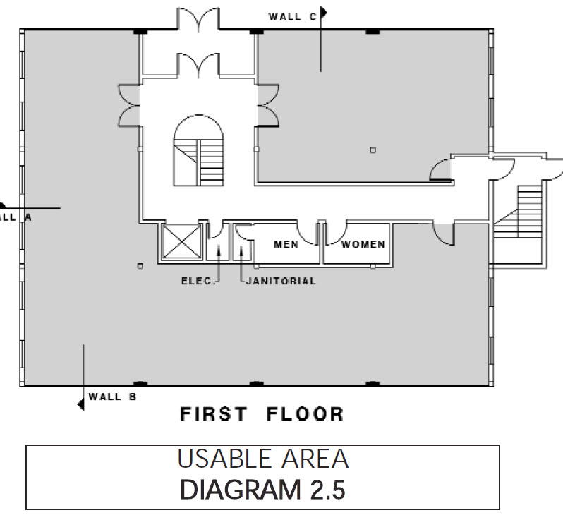
SPACE MEASUREMENTS
Usable Area

Slide 59
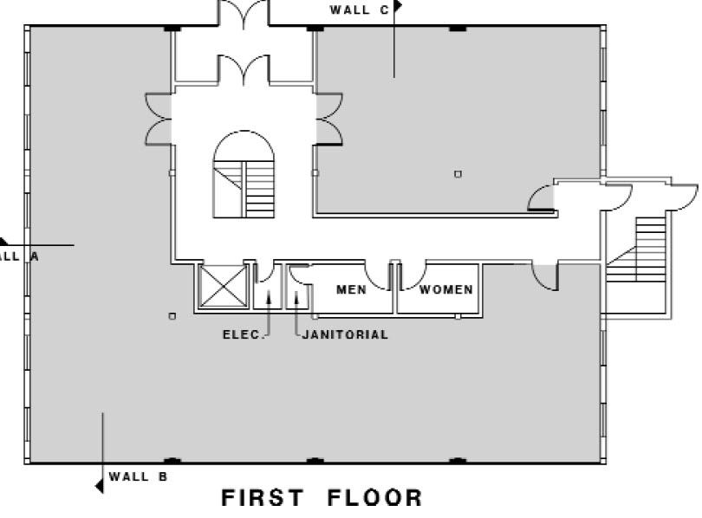
SPACE MEASUREMENTS
Common Area (in white)

Slide 60
EFFECTIVE GROSS INCOME
Gross Income
Less: Vacancy
Effective Gross Income

Slide 61
NET OPERATING INCOME
Effective Gross Income (EGI)
Less: Operating Expenses
Less: Fixed Expenses
Net Operating Income (NOI)

Slide 62
CASH FLOW
Net Operating Income
Less: Mortgage Payments*
Cash Flow
*AKA Debt Service

Slide 63
Know The Buyers and Sellers

Slide 64
BUYERS / SELLERS
Reasons to use a broker
Motivation for buying and selling
Goals and objectives

Slide 65
REASON TO USE A BROKER
Lack of marketing knowledge
Other time commitments
Out of town ownership

Slide 66
REASON TO USE A BROKER
Partnership ownership
Personality conflicts
Broker will enhance value through marketing skills

Slide 67
MOTIVATION
Change in investment criteria
Need for capital
Desire to invest in own building

Slide 68
MOTIVATION
Change in size of business
Ownership disputes
Shelter income from income taxes

Slide 69
GOALS AND OBJECTIVES
Maximize return on investment
Investment with secure income
Need to change size of property

Slide 70
GOALS AND OBJECTIVES
Diversification of portfolio
Pride of ownership
Change in investment criteria
Maximize income and return on the investment

Slide 71
Know The Market

Slide 72
MARKET TRENDS
Economic
Macro - Overall economic trends
Micro - Local market conditions

Slide 73
REAL ESTATE CYCLES
Low Vacancies > Increasing prices
Increasing Prices > Increasing Construction
Increasing Construction > Oversupply
Oversupply > Increasing vacancy
Increasing Vacancy > Declining prices
Declining Prices > Declining Construction
Declining Construction > Low Vacancies

Slide 74
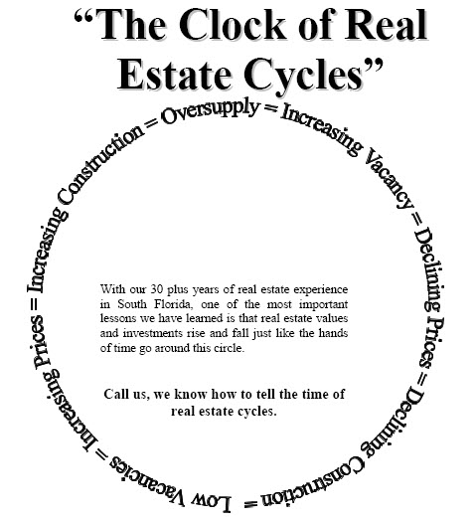

Slide 75
BROKERAGE SPECIALIZATION
By Product Type
Geographical Area
Transaction Size
Client Type

Slide 76
PROSPECTING & MARKETING
High Volume of Contacts
Low Volume and Focused Contacts
Priority of Targets
Sources of Contacts

Slide 77
PRESENTATION BOOK
Description of marketing process
Generic marketing plan
Sample marketing material

Slide 78
PRESENTATION BOOK
Company information
Personal information
Press releases / Letters of Recommendation
Benefit of Exclusive Representation

Slide 79
BENEFITS OF EXCLUSIVE
Single Point of Contact
Understanding of Owner’s Needs
Commitment to Market the Property

Slide 80
BENEFITS OF EXCLUSIVE
Commitment to represent the owner’s interests
Best deal
Shortest time
Least inconvenience
Lowest cost to owner

Slide 81
MARKETING PLAN
Identifies target prospects
Sets up the means and methods to contact them
Develops selling themes which present the property’s features as benefits to the targeted user

Slide 82
MARKETING PROCESS
Pricing
Appraisals
Competitive Market Analysis (CMA)

Slide 83
MARKETING PROCESS
Targeting
General Category
Segment
Company

Slide 84
MARKETING PROCESS
Planning
Potential prospects
Marketing budgets
Activity reporting plan

Slide 85
MARKETING PROCESS
Planning & Adjustment
Change the rates or prices
Offer more inducements
Make property improvements

Slide 86
MARKETING PROCESS
Executing The Plan
Timing
Measuring results
Reporting the results

Slide 87
MARKETING PROCESS
Signs
Newspapers Ads and Stories
Multiple Listing Service

Slide 88
MARKETING PROCESS
Loopnet/Co-Star
Crexi / MLS
RPR - Realtors Property Resource
Direct Mail – Hoovers.com & EDD
Social Media
LinkedIn

Slide 89
BROKERAGE PROCESS
Property Tour/Inspections
Letter of Intent
Outline of major terms
Deadline to prepare contract

Slide 90
BROKERAGE PROCESS
Contract
Feasibility Study and Inspections
Closing
Celebration……

Slide 92
REAL ESTATE ORGANIZATIONS
BOMA Building Owners and Managers Association
www.boma.org
Apartments
Office Buildings
Warehouse/Industrial

Slide 93
REAL ESTATE ORGANIZATIONS
NAIOP
National Association of Industrial and Office Parks
www.naiopsfl.com
Warehouse/Industrial/Office Buildings

Slide 94
REAL ESTATE ORGANIZATIONS
SIOR
Society of Industrial Realtors
Warehouse/Industrial
www.sior.com

Slide 95
REAL ESTATE ORGANIZATIONS
IREM
Institute of Real Estate Management
www.irem19.org
Certified Property Manager (CPM)
Residential Property Manager (RPA)

Slide 96
REAL ESTATE ORGANIZATIONS
CCIM
Commercial Investment Real Estate Institute
http://flccim.com/districts/miami/

Slide 97
REAL ESTATE ORGANIZATIONS
CREW
Commercial Real Estate Women www.crewmiami.org
CIASF
Commercial Industrial Association of South Florida www.ciasf.com

Slide 98
THE NEXT STEP
Learn - Take classes from other brokers
Join - Organizations in your area of specialization/Participate/Network
Become active in the organization

Slide 99
Become a Commercial Realtor

